Slide 1
Models and bindings
Jon Galloway | Technical Evangelist
Christopher Harrison | Content Developer

Slide 2
Models and bindings
Creating a model
Binding data and observables
Computed observables

Slide 3
Creating a model

Slide 4
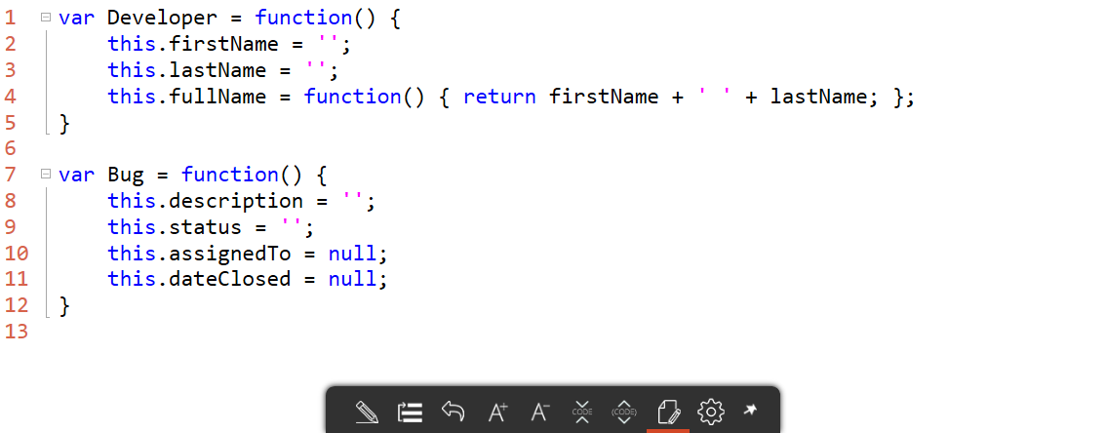
What’s a model?
A model is nothing more than a JavaScript class

Slide 5
Creating the model

Slide 6
Binding concepts

Slide 7
The goal of Knockout is to ease data binding
You can bind pretty much any JavaScript object’s property to pretty much any property in HTML
Common bindings
value
text
css (for classes)
visible
disable or enable
See knockoutjs.com documentation for the full list of bindings. There’s a lot of them!

Slide 8
Some binding keywords
Typically Knockout will figure out where you are automatically
But there be times when you need to explain to Knockout where a particular object or function is
Available keywords
$data
Current object
$parent
Parent of the current object
$root
Bound view model

Slide 9
Our first binding
Notes:
Create (or show) the developer JavaScript file
Show a textbox/div
Show changes aren’t reflected

Slide 10
Observables and two way binding

Slide 11
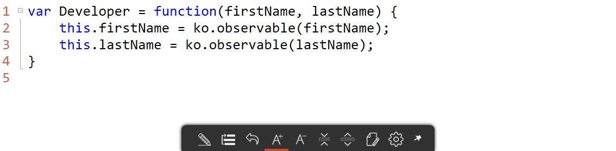
Observables
Values may change
Knockout provides the ability to update us when those values change through observables

Slide 12
Two way bindings with observables
Notes:
Update the Developer class to make the firstName and lastName ko.observable

Slide 13
Computed observables

Slide 14
Sometimes, we need to perform a calculation
Show a project is past due
Provide simpler data for view, such as full name

Slide 15
Knockout provides two types of calculations
computed
Basic calculation
Might have “side effects” (change the data)
pureComputed
Basic calculation
No side effects
Better performance
Typically what you want to use

Slide 16
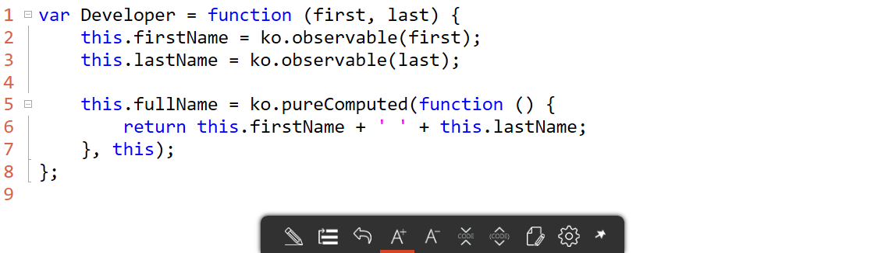
Creating pureComputed (or computed)
Two parameters
Function to return the value
What object will represent this

Slide 17
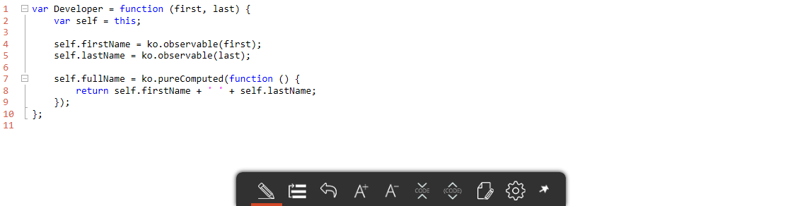
Some design notes
A pureComputed is essentially an event handler
this represents whatever raised the event
Need to tell Knockout what this is
Typical pattern to avoid this is to set a variable to represent the object

Slide 18
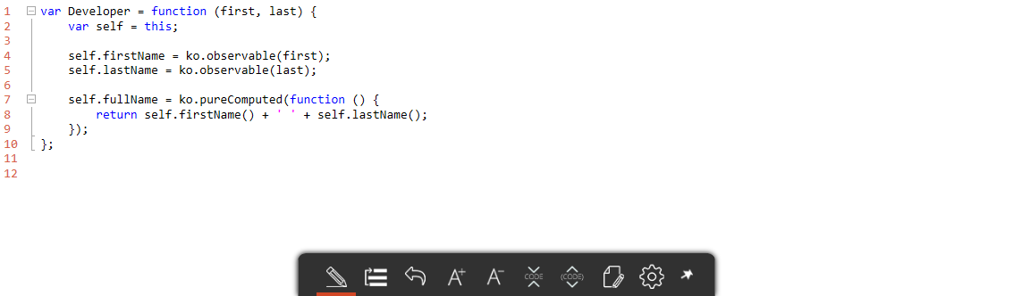
More design notes
Knockout’s observable is a wrapper for the actual value
If you want the actual value you need to call the function to retrieve it

Slide 19
Computed values
Notes:
Add the computed value

Slide 20
CSS binding

Slide 21
Forms

Slide 22
Observable arrays

Slide 23
Knockout also allows collections to be observable
Wrapper for JavaScript arrays
Provides additional functionality
Methods
unsplit(object)
Top of the list
push(object)
Bottom of the list
split
Remove and return the top object
pop
Remove and return the bottom object

Slide 24
Arrays and foreach bindings

Slide 25
Options binding
You can also bind an array to a dropdown list
Bindings
options
The array of objects
optionsText
Property to use for display
optionsCaption
Text to display as prompt
value
Pre-bind selected value

Slide 26
Create bug

